Slide 1

Testing the Digital Frontier:
Validity Trade-offs in Online Platform A/B Testing
Yann Cornil, Shangwen Yi, Johannes Boegershausen, & David J. Hardisty
EACR, July 7 2023

Slide 2



Co-Authors
Yann Cornil
Shangwen Yi
Johannes Boegershausen
University of British Columbia
University of British Columbia
Rotterdam School of Management

Slide 3
Online Platform AB Testing
The average person spends 6 hours and 58 minutes looking at their screen each day doing internet-connected activities (We are Social 2022)
Researchers are keen to test their theories in online field studies with large and diverse samples
Online advertising platforms such as Facebook (Meta) and Google offer convenient tools at a reasonable cost

Slide 4

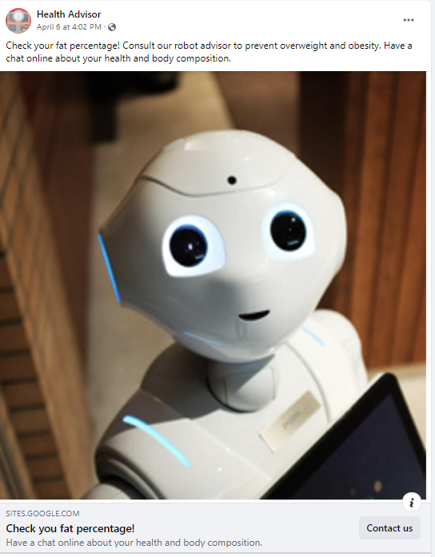
PABT Example: Human vs Robot Doctor

Slide 5
Platform AB Testing (PABT)
“AB Testing” is an ambiguous term
PABT Definition: studies that are run in a naturalistic online environment and that aim to compare the effect of different stimuli (in particular ads) by using the A/B testing functionalities provided by digital platforms, such as Facebook or Google Ads
Varying perspectives on the validity and usefulness of PABT
(Braun & Schwartz, 2022; de Langhe & Puntoni, 2021; Eckles, Gordon, & Johnson, 2018; Johnson, 2023; Kohavi & Thomke, 2017; Mosleh, Pennycook, & Rand, 2022; Orazi & Johnston, 2020)
Distinct from:
Fully randomized controlled trials (RCTs) run in partnership with an organization
Holdout (or “lift”) tests – examine effect of advertisement exposure vs no exposure

Slide 6
PABT BY DISCIPLINE (2012-2022)
Notes:
The figure shows the number of PABT organized by discipline mapped over time.

Slide 7
Platform AB Testing: Validity Tradeoffs
The benefits of PABT are clear: relatively quick, relatively inexpensive, ecologically-valid field data.
But: platform documentation is ambiguous and sometimes misleading, hiding a critical flaw for researchers: “divergent delivery” compromises internal validity, so we cannot make clean causal inferences.
PABT cannot replace a fully-random experiment!
PABT are constantly changing “black boxes”
Meaning of clicks is ambiguous
PABT data typically violates independent sampling assumptions of common statistics
PABT should only be used as a “proof of concept” or case example (similar to many secondary data sources), rather than a clean test of theory

Slide 8
Outline
PABT case example
Review of current practices in all 76 PABT published (through 2022)
Recommendations for researchers & reviewers

Slide 9

Case Example

Slide 10


PABT Case Example: Holthöwer & van Doorn (2022)
Research question: are people more interested in robot service providers for embarrassing topics?
Study 2: Facebook AB Test, N (“reach”) = 11,815; United Kingdom ages 18-65+
2x2 Between-Participants Design:
High Embarrassment: Check your fat percentage! Consult our robot (human) advisor to prevent overweight and obesity. Have a chat online about your health and body composition.
Low Embarrassment: Check your fat percentage! Consult our robot (human) advisor to assess your fitness and nutritional diet. Have a chat online about your health and body composition.

Slide 11
Holthöwer & van Doorn (2022): Click-Through-Rates
High Embarrassment (“prevent overweight and obesity”) | 0.74% | 1.26%
Low Embarrassment (“assess your fitness and nutritional diet”) | 0.73% | 0.93%
p = .037
p = .37

Slide 12
How Much Effect Does Optimization Have?
Test of Replication and Robustness Study

Slide 13
Replication and Extension of Holthöwer & van Doorn (2022)
Three distinct A/B tests launched simultaneously, over a three-day period
Each test compared Robot Ad vs Human Ad (high embarrassment conditions only)
Optimized on “Link Clicks” vs “Impressions” vs “Reach with frequency cap”
Budget of USD 200 per test (i.e., USD 100 per ad)
Total N (impressions) = 267,151, USA, all ages
Pre-registered: https://aspredicted.org/D2B_DT8

Slide 14
Results: Click-Through-Rates
 | Clicks |  | Impression |  | Reach w/ Cap
Ad Version | Human | Robot | Human | Robot | Human | Robot
Impressions | 11,874 | 11,735 | 62,581 | 61,808 | 59,554 | 59,599
Reach | 8,760 | 9,268 | 25,400 | 24,208 | 59,345 | 59,056
Unique Link Clicks | 120 | 152 | 23 | 23 | 22 | 29
CTR1 (Unique Link Clicks/Impression) | 1.01% | 1.30% | 0.04% | 0.04% | 0.04% | 0.05%
CTR2 (Unique Link Clicks/Reach) | 1.37% | 1.64% | 0.09% | 0.10% | 0.04% | 0.05%
p=.04
p=.14

Slide 15
Results: Divergent Delivery
 | Clicks |  | Impression |  | Reach w/ Cap
Ad Version | Human | Robot | Human | Robot | Human | Robot
Frequency (Impression/Reach) | 1.36 | 1.27 | 2.46 | 2.55 | 1 | 1.01
Proportion of Women among exposed | 52.3% | 38.5% | 35.3% | 29.5% | 34.0% | 31.5%
CTR1 among men | 0.98% | 1.34% | 0.04% | 0.04% | 0.03% | 0.04%
CTR1 among women | 1.02% | 1.24% | 0.04% | 0.03% | 0.04% | 0.05%
Average age of exposed users | 62.11 | 62.71 | 54.06 | 53.41 | 53.5 | 53.85

Slide 16
Results: Other User Reactions
 | Clicks |  | Impression |  | Reach w/ Cap
Ad Version | Human | Robot | Human | Robot | Human | Robot
Comments | 2 | 3 | 0 | 0 | 0 | 0
Post Reactions | 11 | 3 | 1 | 0 | 0 | 0

Slide 17
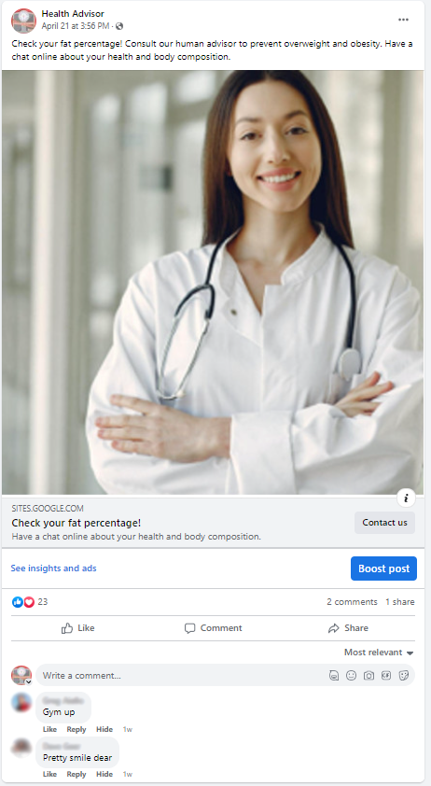
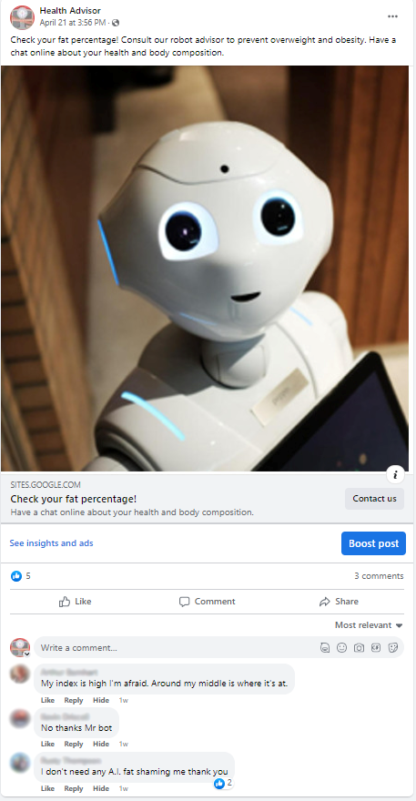

Slide 18
Case Study: Takeaways
When optimizing on clicks:
Replicated previous results
Evidence of divergent delivery
  The robot ad was shown to more men than women
  Men were more likely to click the robot ad
Evidence of divergent reactions
In short, PABT do not test “A” vs “B”. They test “A+optimization+reactions” vs “B+optimization+reactions”.

Slide 19
Case Study: Takeaways
When optimizing on impressions or capped reach:
Very low click through rates (below industry standards)
Null results
Targeting may be optimized for users unlikely to click
No evidence of divergent delivery (but may still happen on unobservables)

Slide 20
Review of Current Practice

Slide 21
PABT: Review of Current Practice
Review and coding of all 76 PABT published (through 2022)
CTR is a dependent variable in 97% of studies, yet the exact operationalization of CTR varies significantly:
  Numerator: “total clicks” vs “unique clicks”
  Denominator: “reach” vs “impressions”
Median sample size per condition
  38,532 ad exposures (among the 44 PABT that report “impressions” or “views”)
  18,067 users exposed to the content (among the 25 PABT that report “reach”).
57.9% mislabeled PABT as a (true) experiment
Only 21.1% discussed the lack of true randomization

Slide 22
Recommendations

Slide 23
Recommendations
Consider whether PABT is useful for your project
Study actual marketplace offerings, with realistic advertising campaigns
Target business-relevant populations
When possible, study diverse (and non-WEIRD) populations
Focal analyses should be preregistered
All potential metrics used in the computation of the clickthrough rate should be reported (unique/total clicks, impression, reach)
Report a) campaign duration, b) budget, c) optimization type, d) sampling strategy, and e) user reactions (likes, comments)

Slide 24
Recommendations
Correctly characterize the study by explicitly acknowledging the non-random delivery of treatments (i.e., divergent delivery)
Engage in stimulus sampling and close replications
(e.g., pair PABT with a matched lab study)
Report impression-to-reach ratio across conditions and sample ratio mismatch to inform readers of the divergent delivery
Consider advanced approaches to manipulate audience quality (e.g., random bidding process), at the expense of ecological validity

Slide 25

Summary & Conclusions
PABT offer high ecological validity but lower internal validity
PABT should only be used as a complement to, rather than a replacement for, lab-based experiments
With careful design and reporting, PABT can be a useful tool in the modern consumer research toolbox

Slide 26

Thank you!

Slide 27
References
Braun, M., & Schwartz, E. M. (2022). The A-B Test Deception: Divergent Delivery, Response Heterogeneity, and Erroneous Inferences in Online Advertising Field Experiments. working paper, Southern Methodist University.
de Langhe, B., & Puntoni, S. (2021). Are Personalized Ads a Waste of Money? Harvard Business Review Digital Articles.
Eckles, D., Gordon, B. R., & Johnson, G. A. (2018). Field studies of psychologically targeted ads face threats to internal validity. Proceedings of the National Academy of Sciences, 115(23), E5254. doi:10.1073/pnas.1805363115
Holthöwer, J., & van Doorn, J. (2022). Robots do not judge: service robots can alleviate embarrassment in service encounters. Journal of the Academy of Marketing Science, 1-18.
Johnson, G. A. (2023). Inferno: A guide to field experiments in online display advertising. Journal of Economics & Management Strategy, forthcoming. doi:https://doi.org/10.1111/jems.12513
Kohavi, R., & Thomke, S. (2017). The surprising power of online experiments. Harvard Business Review, 95(5), 74-82.
Mosleh, M., Pennycook, G., & Rand, D. G. (2022). Field experiments on social media. Current Directions in Psychological Science, 31(1), 69-75.
Orazi, D. C., & Johnston, A. C. (2020). Running field experiments using Facebook split test. Journal of Business Research, 118, 189-198. doi:https://doi.org/10.1016/j.jbusres.2020.06.053

